Slide 1
Climate Trends and its Impact on Workplace Safety Insurance
Eden Ng
26th May 2023

Slide 2
Problem Statement
Presenter:
Data analyst at an insurance company who is concerned about the climate impact on workplace safety insurance
Audience:
Actuarial and Marketing team

Slide 3
Background Research
Studies have explored the relationship between weather and workplace safety and found that climate trends can have an adverse impact on workplace safety and actuarial models.

Slide 4
Datasets
Weather Datasets:
Data.gov.sg
Workplace Accidents Dataset:
Ministry of Manpower's annual workplace safety and health (WSH) reports.

Slide 5
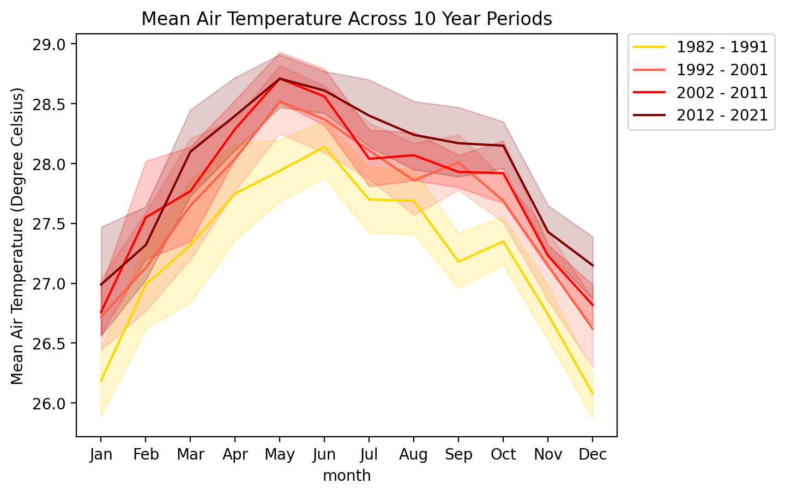
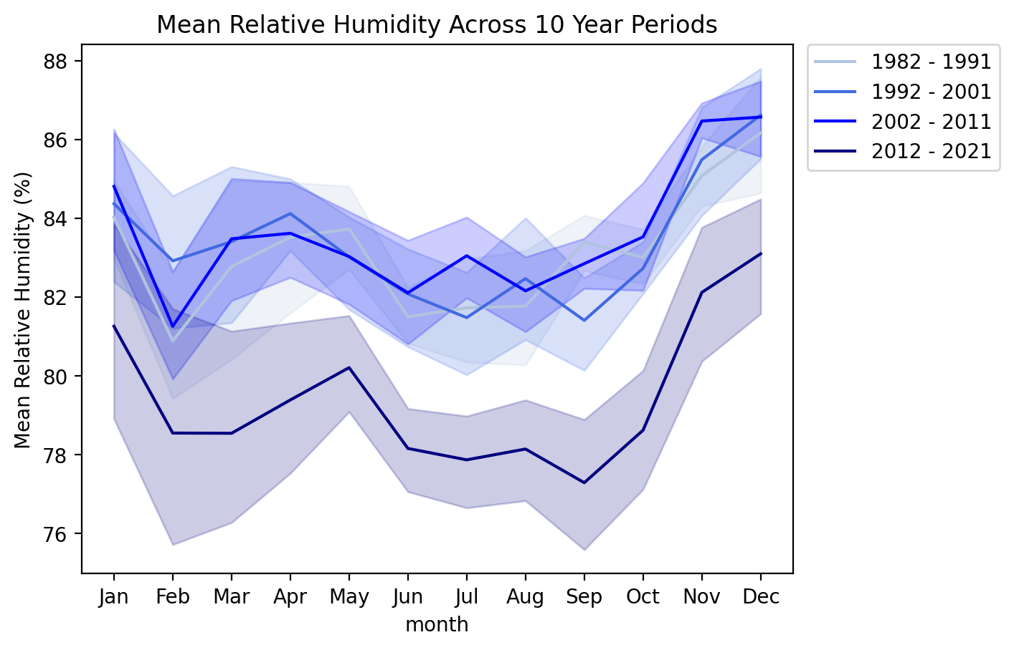
Climate Trends

Slide 6
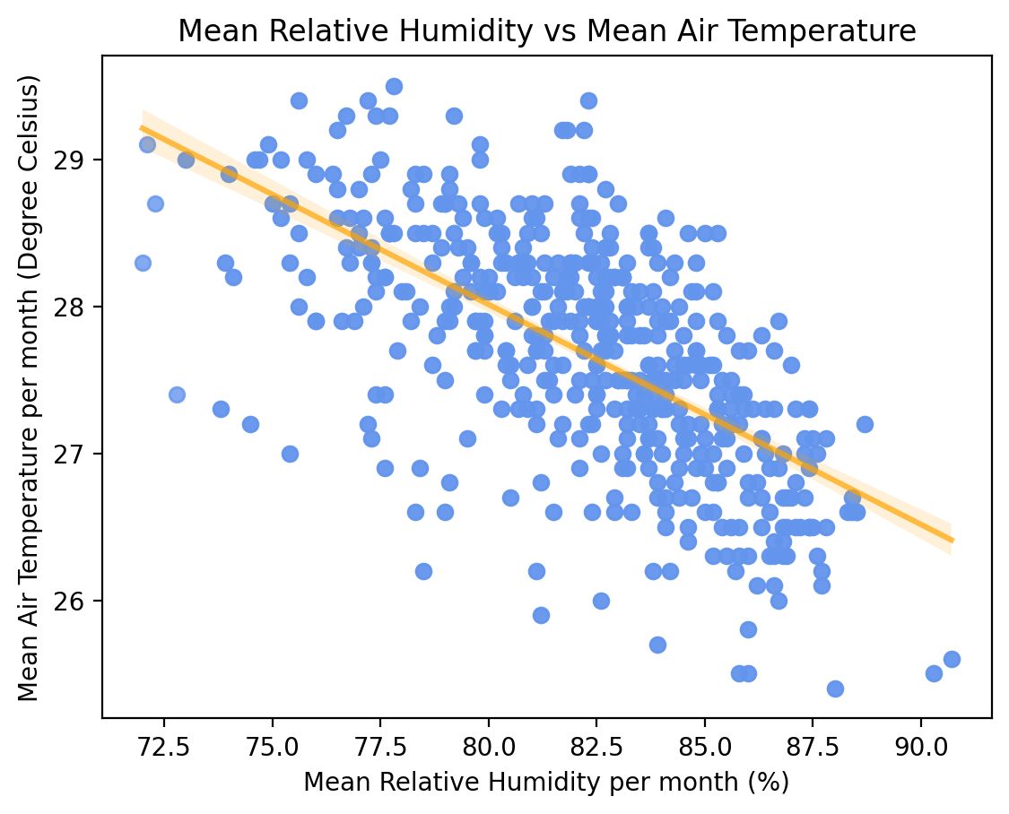
Climate Trends
Correlation:
-0.63

Slide 7
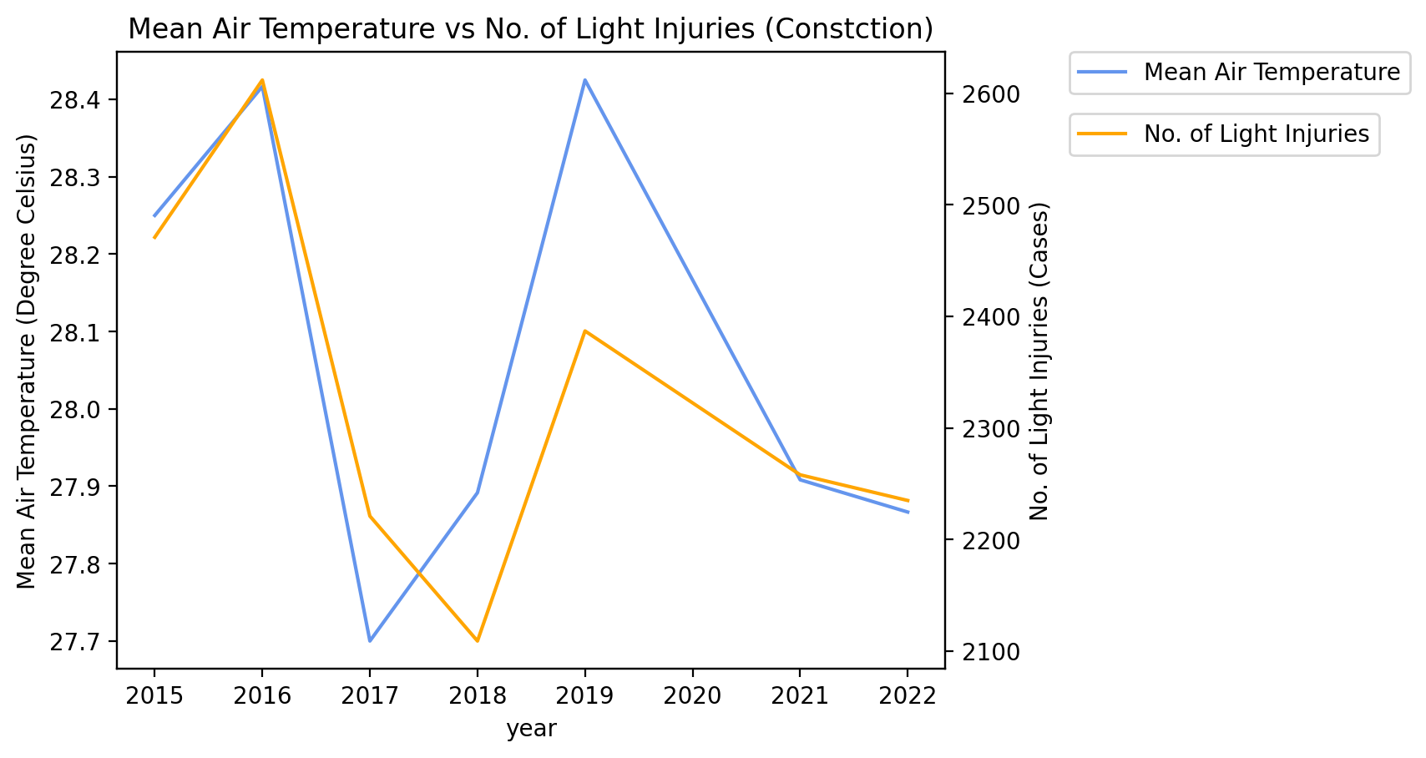
Correlation between Mean Temperature and Light Injuries (Construction)
Correlation:
0.84

Slide 8
Recommendations
Actuarial team should look into adequately accounting for the increase in temperature to their long-term workplace safety pricing models and prevent adverse selection by policyholders (Storey et al., 2019).
Develop an Actuaries Climate Index (ACI), which seeks to quantify changes in extreme weather events and sea level rise.

Slide 9
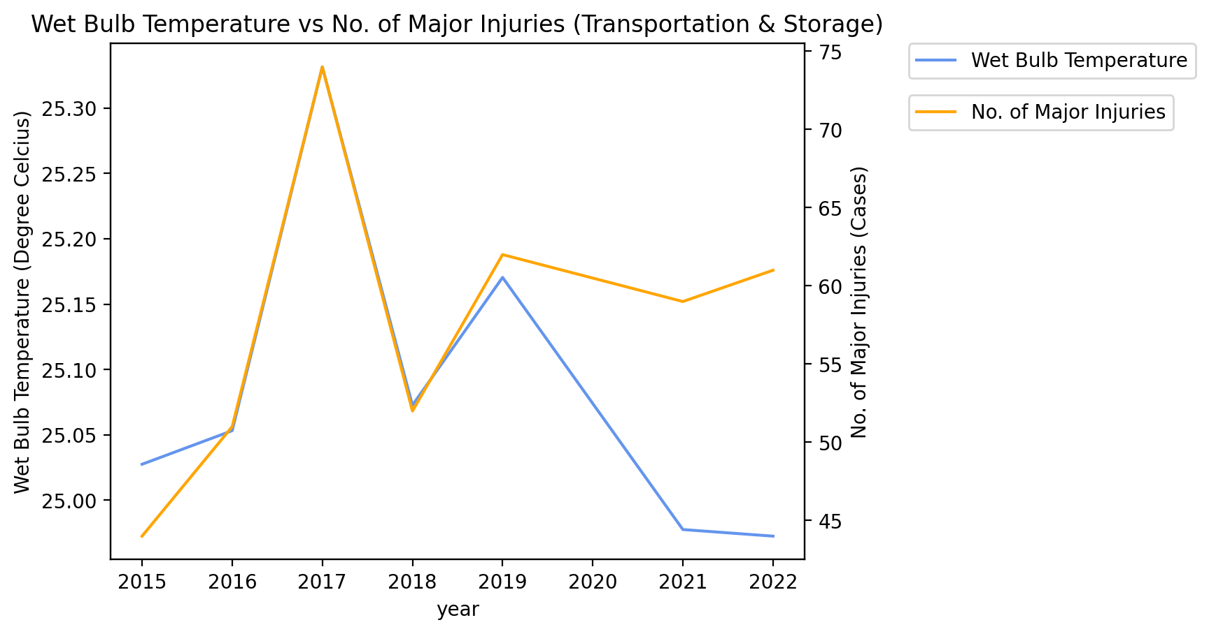
Correlation between Wet Bulb Temperature¹ and Major Injuries (Transportation & Storage)
Correlation:
0.67
¹ wet bulb temperature mirrors how the human body cools itself with sweat

Slide 10
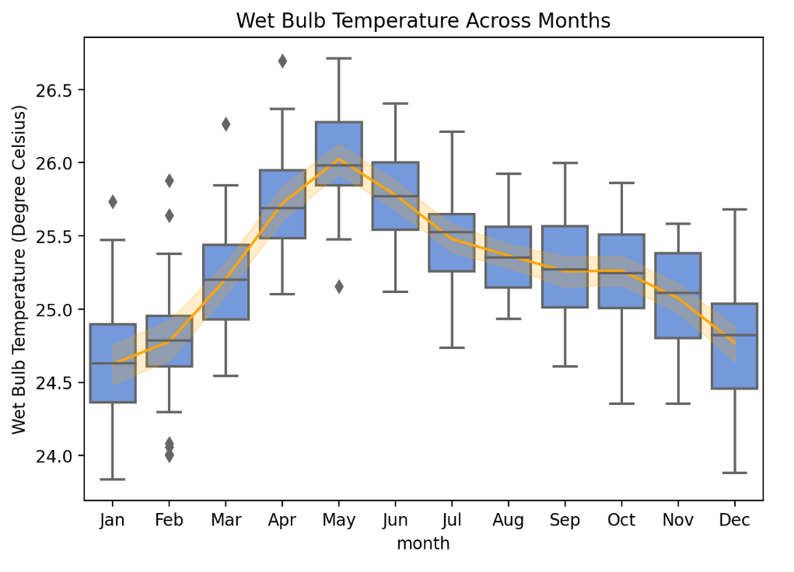
Wet Bulb Temperature Across Months
Highest:
Apr to Jul
Lowest:
Dec to Jan

Slide 11
Recommendations
Actuarial team should look into increasing prices for Collision Damage Waiver² for the months between April and July to prevent adverse selection by policyholders .
Marketing team should increase marketing efforts for the months between April and July.
² a temporary vehicle insurance one can purchase on a monthly basis to cover a large portion of their insurance premiums, typically around 90%, should they get into an accident

Slide 12
Conclusion
Strong correlation between climate trends and workplace accidents
Proactively seek out implications of climate trends to:
prevent adverse selection
improve pricing models
gather marketing insights

Slide 13
Thank You

Slide 14
Citations
McQuillan, L. (2022, July 20). Too hot to handle: How to survive amid extreme heat and humidity. CBC. Retrieved May 25, 2023, from https://www.cbc.ca/news/health/heat-humidity-bodies-wet-bulb-1.6525711#:~:text=The%20hotter%20and%20more%20humid,others%2C%20according%20to%20Health%20Canada.
Medvigy, D., & Beaulieu, C. (2012). Trends in Daily Solar Radiation and Precipitation Coefficients of Variation since 1984. Journal of Climate, Volume 25(Issue 4), 1330–1339. https://doi.org/10.1175/2011JCLI4115.1
Park, RJ, Pankratz, N, Behrer, AP (2021) Temperature, workplace safety, and labor market inequality. Discussion Paper Series 14560, IZA Institute of Labor Economics. Retrieved May 25, 2023, from https://ftp.iza.org/dp14560.pdf
Storey, C., MacFarlane, A., Spira, J., Davangere, M., Thulliez, M., Bagree, N., Hughes, R., & Watt, S. (2019). Climate Change for Actuaries: An Introduction. Institute and Faculty of Actuaries. Retrieved May 25, 2023, from https://www.actuaries.org.uk/system/files/field/document/Climate-change-report-29072020.pdf
Willett, K. (2020, December 1). Guest post: Investigating climate change’s ‘humidity paradox.’ Carbon Brief. Retrieved May 25, 2023, from https://www.carbonbrief.org/guest-post-investigating-climate-changes-humidity-paradox/

